Slide 1
Distributed Deadlock Detection

Slide 2
References:
Mukesh Singhal, Niranjan Shivaratri. “Advanced concepts in operating systems”. Tata McGraw Hill publication.

Slide 3
Introduction
Deadlock: a situation where a process or set of the process is blocked, waiting on an event that will never occur.
Avoiding performance degradation due to deadlocks requires that a system be deadlock free or that deadlocks be quickly detected and eliminated.
Deadlock in distributed systems are similar to deadlocks in single processor systems, only worse.
  They are harder to avoid ,prevent or even detect.
  They are hard to cure because all relevant information is scattered over many machines.
In Distributed Systems, a process can request and release resources in any order
If the sequence of allocation is not controlled, deadlocks can occur

Slide 4
Assumptions:
  System has only reusable resources
  Only exclusive access to resources
  Only one copy of each resource
  States of a process: running or blocked
    Running state: process has all the resources
    Blocked state: waiting on one or more resource

Slide 5
Types of Resources
Reusable resource:
  Description:
    Used by one process at a time and not consumed by that use
    Processes obtain resources that they later release for reuse by other processes
  Examples:
    Processor , I/O channels, main and secondary memory, files, databases
Consumable resources
  Description:
    Created (produced) and destroyed (consumed) by a process
  Examples:
    Interrupts, signals, messages, and information in I/O buffers

Slide 6
Necessary Conditions for Deadlock
Deadlock can arise if four conditions hold simultaneously.
Mutual exclusion: only one process at a time can use a resource (One process holds a resource in a non-sharable mode & Other processes requesting resource must wait for resource to be released).
Hold and wait: a process holding resource(s) is waiting to acquire additional resources held by other processes.
No preemption: Resources not forcibly removed from a process holding it, a resource can be released only voluntarily by the process upon its task completion.

Slide 7
Necessary Conditions for Deadlock
Circular wait: A closed chain of processes exists.
A set {P₀, P₁, …, P_{n}} of waiting processes such that :
P₀ is waiting for a resource that is held by P₁,
P₁ is waiting for a resource that is held by P₂, …,
P_{n–1} is waiting for a resource that is held by P_{n},
and P_{n} is waiting for a resource that is held by P₀.

Slide 8
Types of Deadlocks
Resource Deadlocks
  Processes can simultaneously wait for several resources and can not proceed until they have acquired all those resources.
  Deadlock occurs if each process in a set request resources held by another process in the same set, and it must receive all the requested resources to move further.
Communication Deadlocks
  Each process is waiting for communication (process’s message) from another process, and will not communicate until it receives the communication for which it is waiting.

Slide 9
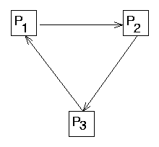
Wait-For Graphs (WFG)
In DS, the system state can be modeled by a directed graph called a wait-for-graph(WFG).
Wait-for Graphs (WFG): P1 -> P2 implies P1 is waiting for a resource from P2.
WFG in databases
  Transaction-wait-for Graphs (TWF)
    Nodes are transactions and T1→T2 indicates that T1 is blocked and waiting for T2 to release some resource

Slide 10
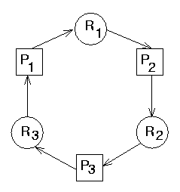
Single-Unit Resource Allocation Graphs
Nodes correspond to processes and resources.
The simplest request model since a process is resticted to requesting only one unit of a resource at a time.
The outdegree of nodes in the WFG is one.
A deadlock corresponds to a cycle in the wait-for-graph, provided that there is only one unit of every resource in the system.

Slide 11
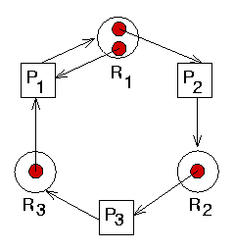
Multiunit Resource Allocation Graphs

Slide 12
Resource allocation graph
To represent the state of process & resource interaction in DS
Nodes of a graph → processes and resources.
Edges of a graph → pending requests or assignment of resources.
A pending request is represented by a request edge directed from the node of a requesting process to the node of the requested resource
A resource assignment is represented by an assignment edge directed from the node of an assigned resource to the node of the assigned process.

Slide 13
Resource Allocation Graph
Process
Resource Type with 4 instances
P_{i} requests instance of R_{j}
P_{i} is holding an instance of R_{j}
P_{i} releases an instance of R_{j}
P_{i}
R_{j}
The sequence of
Process’s resource utilization
Request edge
P_{i}
Assignment edge
P_{i}

Slide 14
Resource allocation graph
System is deadlocked if its resource allocation graph contains a directed cycle or a knot
  A knot in a directed graph is a collection of vertices and edges with the property that every vertex in the knot has outgoing edges, and all outgoing edges from vertices in the knot terminate at other vertices in the knot.

Slide 15
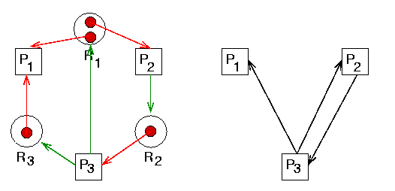
Resource allocation graph
A cycle with no deadlock, and no knot.

Slide 16
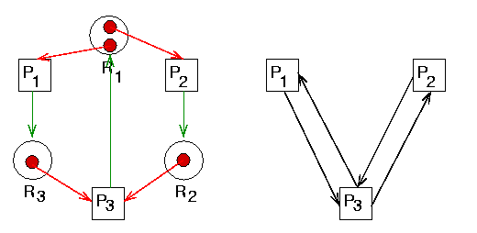
Resource allocation graph
A knot is a sufficient condition for deadlock.

Slide 17
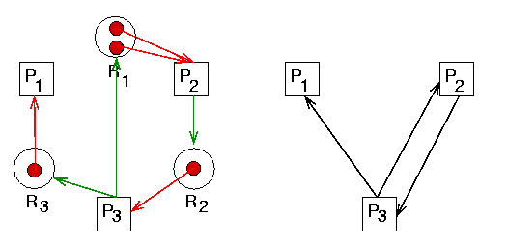
Resource allocation graph
A knot is not a necessary condition for deadlock.

Slide 18

Resource-allocation graph
Can a deadlock happen?

Slide 19

Resource-allocation graph
Can a deadlock happen?
There are two cycles found.

Slide 20

Resource Allocation Graph With A Cycle But No Deadlock
If graph contains no cycles ⇒ no deadlock.
If graph contains a cycle ⇒
  if only one instance per resource type, then deadlock.
  if several instances per resource type, possibility of deadlock.

Slide 21
AND, OR Models
AND Model
  A process/transaction can simultaneously request for multiple resources.
  Remains blocked until it is granted all of the requested resources.
  Resource deadlocked processes are modeled by AND
  A cycle is sufficient to declare a deadlock with this model
OR Model
  A process/transaction can simultaneously request for multiple resources.
  Remains blocked till any one of the requested resource is granted.
  Communication deadlocks are modeled by OR
  A cycle is a necessary condition
  A knot is a sufficient condition

Slide 22
Deadlock Handling Strategies
There are three strategies for handling deadlocks, viz., deadlock prevention, deadlock avoidance, and deadlock detection.
Deadlock Prevention:
  Resources are granted to requesting process in such a way that granting a request for a resource never leads a deadlock
  Can be achieved by
    either having process acquire all the needed resources simultaneously before it begins execution,
    or by preempting a process that holds the needed resource

Slide 23
Deadlock Handling Strategies
  Many drawbacks
    Decreases the system concurrency
    Set of processes can become deadlocked in resource acquiring phase
    In many systems, future resource requirements are unpredictable

Slide 24
Deadlock Handling Strategies
Deadlock Avoidance:
  Before allocation, check for possible deadlocks.
  A resource is granted to a process if the resulting global system state is safe.
  A state is safe if there exists at least one sequence of execution for all processes such that all of them can run to completion
  Difficult in DS because,
    It needs global state info in each site requiring huge storage and communication requirements
    Due to the large number of processes and resources, it will be computationally expensive to check for a safe state

Slide 25
Deadlock Handling Strategies
Deadlock Detection:
  Resources are granted to requesting processes without any check
  Periodically the status of resource allocation and pending requests is examined
  Find cycles in WFG
  Two favorable conditions:
    Once a cycle is formed in the WFG, it remains until it is detected and broken
    Cycle detection can proceed concurrently with the normal activities of a system

Slide 26
Issues in Deadlock detection and resolution
Two basic issues :
  Detection of existing deadlocks
  Resolution of detected deadlocks
Detection of deadlocks involves:
  Maintenance of the WFG
  Search of the WFG for the presence of cycles(or knots)
Correct deadlock detection algorithm must satisfy the following two conditions:
  Progress—No undetected deadlocks
    Algorithm must detect all existing deadlocks in finite time
  Safety—No false deadlocks
      Algorithm should not report deadlocks which are non-existent

Slide 27
Issues in Deadlock detection and resolution
Resolution
    Breaking existing dependencies in the system WFG
    Roll back one or more processes and assign their resources to other deadlocked processes

Slide 28
Control organizations for Distributed Deadlocks
Centralized Control
  A control site (designated site) constructs global wait-for graphs (WFGs) and checks for directed cycles.
  WFG can be maintained continuously (or) built on-demand by requesting WFGs from individual sites.
  Simple and easy to implement
  Have a single point of failure
    Communication links near the control sites are likely to be congested

Slide 29
Control organizations for Distributed Deadlocks
Distributed Control
  Responsibility for detecting a global deadlock is shared equally among all sites
  The global state graph is spread over many sites and several sites participate in the detection of a global cycle.
  Deadlock detection is initiated only when the waiting process is suspected to be a part of deadlock cycle
  Any site can initiate the deadlock detection process
  Not vulnerable to single point failure
  Difficult to design due to the lack of globally shared memory
  Several sites may initiate detection for the same deadlock

Slide 30
Centralized Algorithms
The completely centralized algorithm
  Control site maintains the WFG of the entire system and checks it for the existence of the deadlock
  Request resource and release resource messages sent by each site to the control site
  Simple and easy to implement
Problem:
  Highly inefficient
  Large delays in user response, large communication overhead, congestion of communication links near the control site
  Poor reliability

Slide 31
Centralized Algorithms
Solution:
  Can be mitigated partially by having each site maintain its resource status (WFG) locally and by having each site send its resource status to a designated site periodically for construction of the global WFG and the detection of deadlocks.
  Due to inherent communication delays and the lack of synchronized clocks, the designated site may get inconsistent view of the system and detect false deadlocks
  Example:
  R1 and R2 are stored at sites S1 and S2
  Transactions T1 and T2 are started at sites S3 and S4 respectively:

Slide 32
Centralized Algorithms
T1 T2
lock R1 lock R1
unlock R1 unlock R1
lock R2 lock R2
unlock R2 unlock R2

Slide 33
Centralized Algorithms
Ho-Ramamoorthy 2-phase Algorithm
  Each site maintains a status table of all local processes initiated at that site: includes all resources locked & all resources being waited on.
  Controller requests (periodically) the status table from each site.
  Controller then constructs WFG from these tables, searches for cycle(s).
  If no cycles, no deadlocks.

Slide 34
Centralized Algorithms
  Otherwise, (cycle exists): Request for state tables again.
  The designated site construct WFG only those transactions which are common to both reports.
  If the same cycle is detected again, system is in deadlock.
  Later proved: cycles in 2 consecutive reports need not result in a deadlock. Hence, this algorithm detects false deadlocks

Slide 35
Centralized Algorithms
Ho-Ramamoorthy 1-phase Algorithm
  Each site maintains 2 status tables: resource status table (for all local resources) and process status table (for all local processes).
  Controller periodically collects these tables from each site.
  Constructs a WFG from transactions common to both the tables.
  No cycle, no deadlocks.
  A cycle means a deadlock.

Slide 36
Centralized Algorithms
Does not detect false deadlocks:
E.g.
  Resource table at S1: R1 is waited upon by P2 (R1← P2)
  Process table at S2: P2 is waiting for R1 (P2→R1)
  then, the edge P2→R1 reflects current system state.

Slide 37
Distributed Algorithms
All sites collectively cooperate to detect a cycle in the state graph that is likely to be distributed over several sites of the system
Initiated when,
  A process is forced to wait and, it can be initiated by the local site of the process.

Slide 38
Classification of Distributed Algorithms
Path-pushing: resource dependency information disseminated through designated paths (in the graph).
Edge-chasing: special messages or probes circulated along edges of WFG. Deadlock exists if the probe is received back by the initiator (single returned probe indicates a cycle).
Diffusion computation: queries on status sent to process in WFG (all queries returned indicates a cycle).
Global state detection: get a snapshot of the distributed system.

Slide 39
Edge-Chasing Algorithm
Chandy-Misra-Haas’s Algorithm for AND model (Resource Model)
  If a process makes a request for a resource which fails or times out, the process generates a probe message and sends it to each of the processes holding one or more of its requested resources.
  Each probe message contains the following information:
    the id of the process that is blocked (the one that initiates the probe message);
    the id of the process is sending this particular version of the probe message; and
    the id of the process that should receive this probe message.
  A probe(i, j, k) is used by a deadlock detection process P_{i}. This probe is sent by the home site of P_{j} to home site of P_{k}.
  This probe message is circulated via the edges of the graph. Probe returning to P_{i} implies deadlock detection.

Slide 40
Edge-Chasing Algorithm
Chandy-Misra-Haas’s Algorithm for AND model (Resource Model)
  Terms used:
    P_{j} is dependent on P_{k}, if a sequence of P_{j}, P_{i1},.., P_{im}, P_{k} exists, such that each process except P_{k} in the scquence is blocked and each process , except the first one (P_{j} ), holds a resource for which the previous process in the secquence is waiting.
    P_{j} is locally dependent on P_{k}, if P_{j} is dependent upon P_{k} and both the processes are at same site.
    Each process maintains a boolean array dependent_{i}: dependent_{i}(j) is true if Pi knows that P_{j} is dependent on it. (initially dependent_{i}(j) set to false for all i & j).

Slide 41
Chandy-Misra-Haas’s Algorithm
Sending the probe:
if P_{i} is locally dependent on itself then deadlock.
else for all P_{j} and P_{k} such that
(a) P_{i} is locally dependent upon P_{j}, and
(b) P_{j} is waiting on P_{k}, and
(c ) P_{j} and P_{k} are on different sites, send probe(i,j,k) to the home
site of P_{k}.
Receiving the probe:
if (d) P_{k} is blocked, and
(e) dependent_{k}(i) is false, and
(f) P_{k} has not replied to all requests of P_{j},
then begin
dependent_{k}(i) := true;
if k = i
then declare that P_{i} is deadlocked
……………….

Slide 42
Chandy-Misra-Haas’s Algorithm
Receiving the probe (contd…):
else for all P_{m} and P_{n} such that
(a’) P_{k} is locally dependent upon P_{m}, and
(b’) P_{m} is waiting on P_{n}, and
(c’) P_{m} and P_{n} are on different sites, send probe(i,m,n)
to the home site of P_{n}.
end.

Slide 43
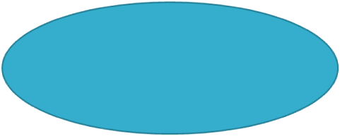
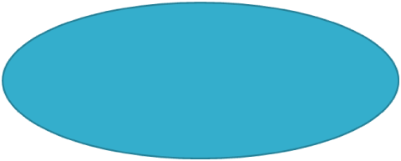
Example
P2
P1
P3
probe(1, 9, 1)
Site S₁
probe(1, 3, 4)
P8
P4
P9
probe(1, 6, 8)
P6
P5
P10
P7
probe(1, 7, 10)
Site S₃
Site S₂

Slide 44
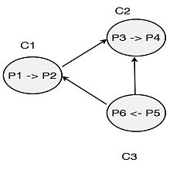
Example
In below example, P₁ initiates the deadlock detection. C₁sends the probe saying P₂ depends on P₃. Once the message is received byC₂, it checks whether P₃ is idle. P₃ is idle because it is locally dependent on P₄ and updates dependent₃(2) to True.
Same as above, C₂ sends probe to C₃ and C₃ sends probe to C₁. At C₁ , P₁ is idle so it update dependent₁(1) to true. Therefore it can be declared a deadlock has occurred.

Slide 45
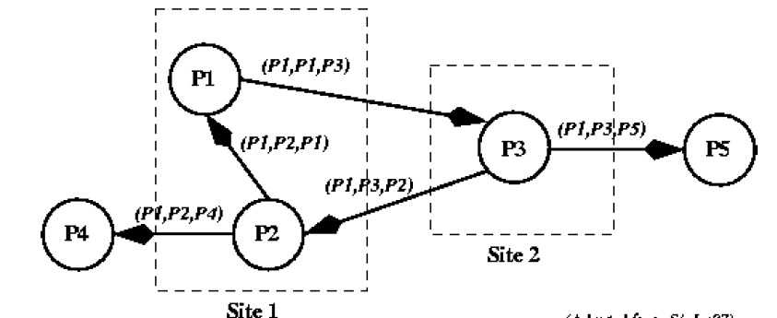
Example
P1 initiates the probe message, so that all the messages shown have P1 as the initiator. When the probe message is received by process P3, it modifies it and sends it to two more processes. Eventually, the probe message returns to process P1. Deadlock!

Slide 46
Example
( 1,7,1 )
Site 3
( 1,1,2 )
( 1,6,7 )
P1
P2
P6
P7
( 1,2,3 )
( 1,5,6 )
Site 1
( 1,2,4 )
Site 2
P3
P1 initiates Deadlock Detection by sending Probe Message (1,1,2) to P2
P4
P5
( 1,4,5 )

Slide 47
Example
If process P11 initiates Chandy-Misra edge chasing algorithm then find out whether deadlock is occurred in the system or not? Justify your answer.
Site 1
Site 2
P11
P21
P32
Site 4
Site 3
P54
P33
P43
P24
P44

Slide 48
Advantages of Chandy-Misra-Hass Deadlock Detection Algorithm
The advantages of this algorithm include the following:
  It is easy to implement.
  Each probe message is of fixed length.
  There is very little computation.
  There is very little overhead.
  There is no need to construct a graph, nor to pass graph information to other sites.
  This algorithm does not find false deadlock.
  There is no need for special data structures.

Slide 49
A Diffusion Computation Based Algorithm
Algorithm for OR model (Communication Model)
Deadlock Detection computation is diffused through WFG of the system
Process can be in two states:
  Active state- a process is executing.
  Blocked state – a process is waiting to acquire a resource.
A blocked process may start a diffusion- by sending query message to all the processes from whom it is waiting to receive a message.
Messages takes two forms
  Query message (i,j,k)
    i = initiator of check
    j = immediate sender
    k = immediate recipient
  Reply message (i,k,j)

Slide 50
A Diffusion Computation Based Algorithm
  Terms used:
Dependent set of process:
  Set of processes from whom the process is waiting to receive message
Engaging query:
  The first query message received for the deadlock detection initiated by Pi.
wait_{k}(i):
  It is a local boolean variable at process P _{k} indicates that it has been continuously blocked since it received the last engaging query from process Pi

Slide 51
A Diffusion Computation Based Algorithm
If an active process receives a query or reply message, it discards it. When a blocked process P_{k} receives a query (i,j,k) message, it takes the following actions:
If this is the first query message receives by P_{k} for deadlock detection initiated by P_{i} (called the engaging query), then it propagates the query to all the processes in its dependent set and sets a local variable num_{k} (i) to the number of query messages sent.
If this is not an engaging query, then P_{k} returns a reply message to it immediately, provided P_{k} has been continuously blocked since it received the corresponding engaging query. Otherwise, it discards the query.
An initiator detects a deadlock when it receives reply messages to all the query messages it had sent out.

Slide 52
Diffusion-based Algorithm
Initiation by a blocked process P_{i}:
send query(i,i,j) to all processes P_{j} in the dependent set DS_{i} of P_{i};
num(i) := |DSi|; wait_{i}(i) := true;
When a blocked process P_{k} receiving query(i,j,k):
if this is engaging query for process P_{k} /* first query from P_{i} */
then
send query(i,k,m) to all P_{m} in DS_{k};
num_{k}(i) := |DS_{k}|; wait_{k}(i) := true;
else if
wait_{k}(i)
then
send a reply(i,k,j) to P_{j}.

Slide 53
Diffusion-based Algorithm
Process P_{k} receiving reply(i,j,k)
if
wait_{k}(i)
then begin
num_{k}(i) := num_{k}(i) - 1;
if
num_{k}(i) = 0 then
if
i = k then declare a deadlock.
else
send reply(i, k, m) to P_{m}, which sent the engaging query.

Slide 54
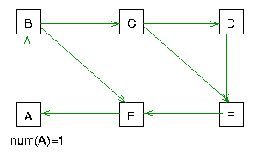
On receipt of query(i,j,k) by m
if not blocked then discard the query
if blocked
  if this is an engaging query
  propagate query(i,j,k)
  else
    if not continuously blocked since engagement then discard the query
    else send reply(i,k,j) to j

Slide 55
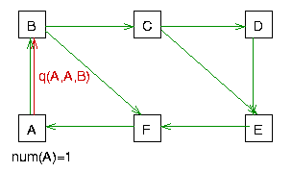
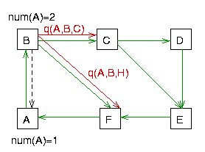
On receipt of query(i,j,k) by m

Slide 56
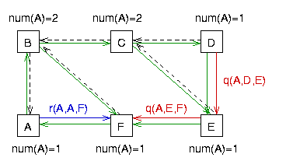
On receipt of query(i,j,k) by m
Num(A)=2
Num(A)=2
Q(A,C,D)
B
C
D
Q(A,C,E)
A
F
E
Num(A)=1
Q(A,F,A)
Num(A)=1

Slide 57
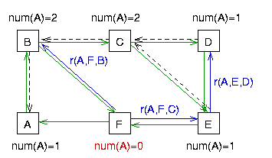
On receipt of reply(i,j,k) by k
if this is not the last reply
then just decrement the awaited reply count
if this is the last reply then
  if i=k report a deadlock
  else send reply(i,k,m)
  to the engaging process m

Slide 58
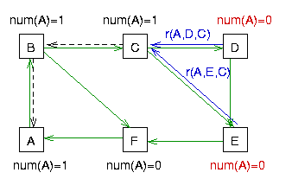
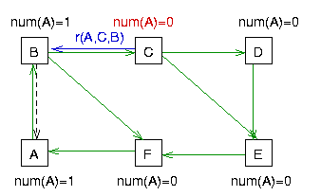
On receipt of reply(i,j,k) by k

Slide 59
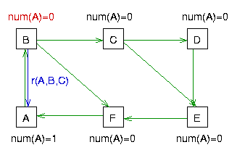
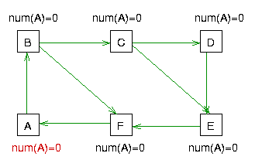
On receipt of reply(i,j,k) by k
Knot detected !

Slide 60
Persistence & Resolution
Deadlock persistence:
  Average time a deadlock exists before it is resolved.
Implication of persistence:
  Resources unavailable for this period: affects utilization
  Processes wait for this period unproductively: affects response time.
Deadlock resolution:
  Aborting at least one process/request involved in the deadlock.
  Efficient resolution of deadlock requires knowledge of all processes and resources.
  If every process detects a deadlock and tries to resolve it independently -> highly inefficient ! Several processes might be aborted.

Slide 61
Deadlock Resolution
Priorities for processes/transactions can be useful for resolution.
  Highest priority process initiates and detects deadlock .
  When deadlock is detected, lowest priority process(s) can be aborted to resolve the deadlock.

